Slide 1
Module 4 – Functional Dependencies & Normalization
Learning Outcome (LO2): Apply techniques of database design including functional dependencies and normalization.

Slide 2
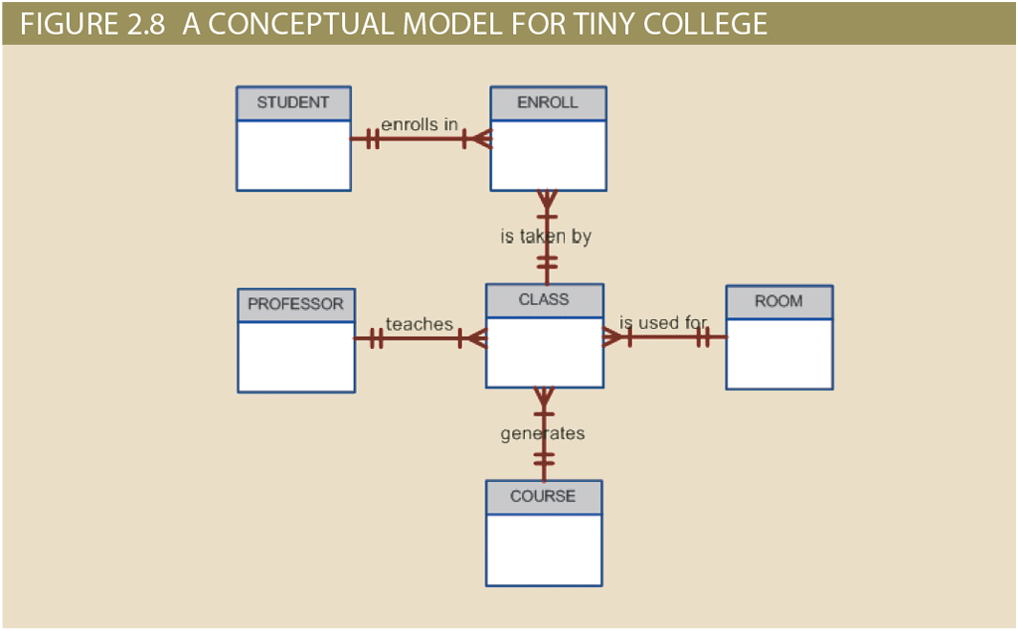
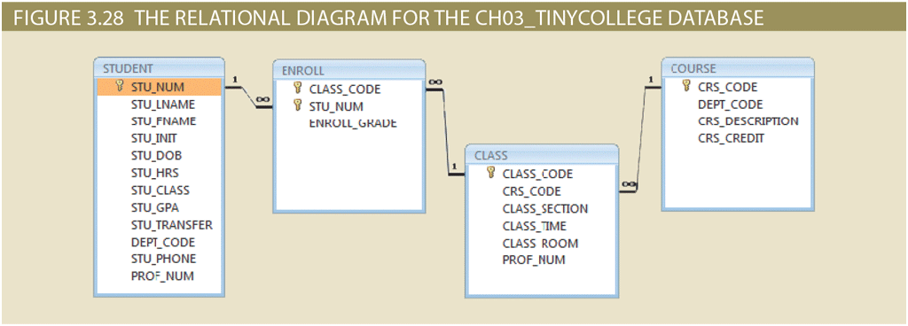
So far ...
Database Design
Gets Mapped
Table Structures
Model / Blueprint
ERD
Relational Model

Slide 3

How do we evaluate whether our table structures are good

Slide 4
What you will learn …
At the end of this class you will be able to:
Explain what normalization is
Explain why we normalize database tables
Explain the process of normalization
Discuss situations where denormalization might be required

Slide 5
How do we evaluate whether our table structures are good

Slide 6
Table structures are good when redundancy is controlled.
Because → Redundancy causes anomalies:
Update anomalies (need to change many rows)
Insertion anomalies (can’t add data without unrelated info)
Deletion anomalies (losing facts when deleting rows)

Slide 7
Examples of Anomalies
Update anomalies (e.g., in the STUDENT–COURSE table: schema STUDENT_COURSE(StudentID, CourseID, Instructor). If Instructor changes, many rows for that course must be updated)
Insertion anomalies (e.g., can’t add a new course until at least one student enrolls)
Deletion anomalies (e.g., deleting the last student from a course may also remove the course information)
Bonus points for producing a visual to show these tables and the redundant data in them. So we can see the anomalies.

Slide 8
The process of finding and then eliminating unnecessary/unwanted redundancies is called Normalization

Slide 9
Finding Redundancies
To find redundancies, we need to examine the relationships between attributes of an entity.
We are looking to find Functional Dependencies (FDs)

Slide 10
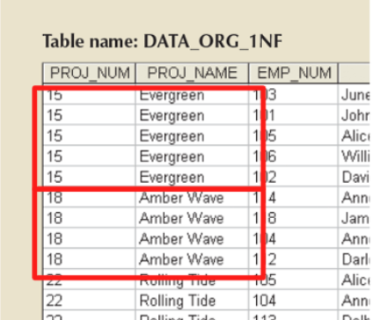
Functional Dependencies (FDs)
Definition: Attribute set X → Y if each value of X maps to exactly one Y.
Example:
PROJ_NUM → PROJ_NAME
EMP_NUM → EMP_NAME
Notation: X → Y

Slide 11
Keys and Dependencies
Superkey: set of attributes uniquely identifying rows.
Candidate key: minimal superkey.
Primary key: chosen candidate key.
Use FDs to validate keys & discover redundancy.
Our goal in analyzing FDs is to validate keys: to check that the chosen key really does uniquely identify tuples without including unnecessary attributes. A good key should be minimal.

Slide 12
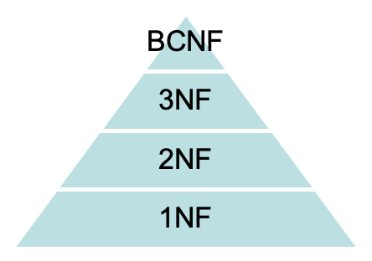
Normalization Overview
Goal: refine schema to reduce redundancy.
Each normal form enforces stricter rules:
1NF – no repeating groups.
2NF – no partial dependencies.
3NF – no transitive dependencies.
BCNF – every determinant is a superkey.

Slide 13

Example
Sample Report for a construction company that wants to bill its clients based on all the job done for their project.
A single report can be an excellent starting point to identify the base data necessary (to produce the report)
So the DB designer records the base data in a table structure

Slide 14
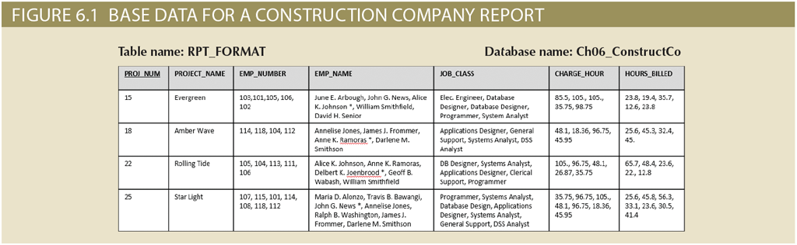
This is not a relational table. Why?

Slide 15
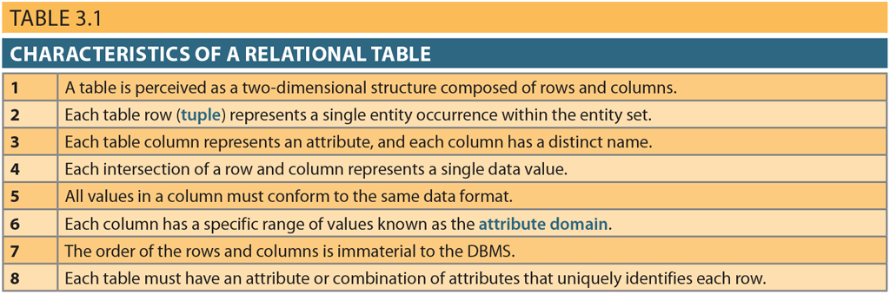
There are multiple values in a single cells

Slide 16
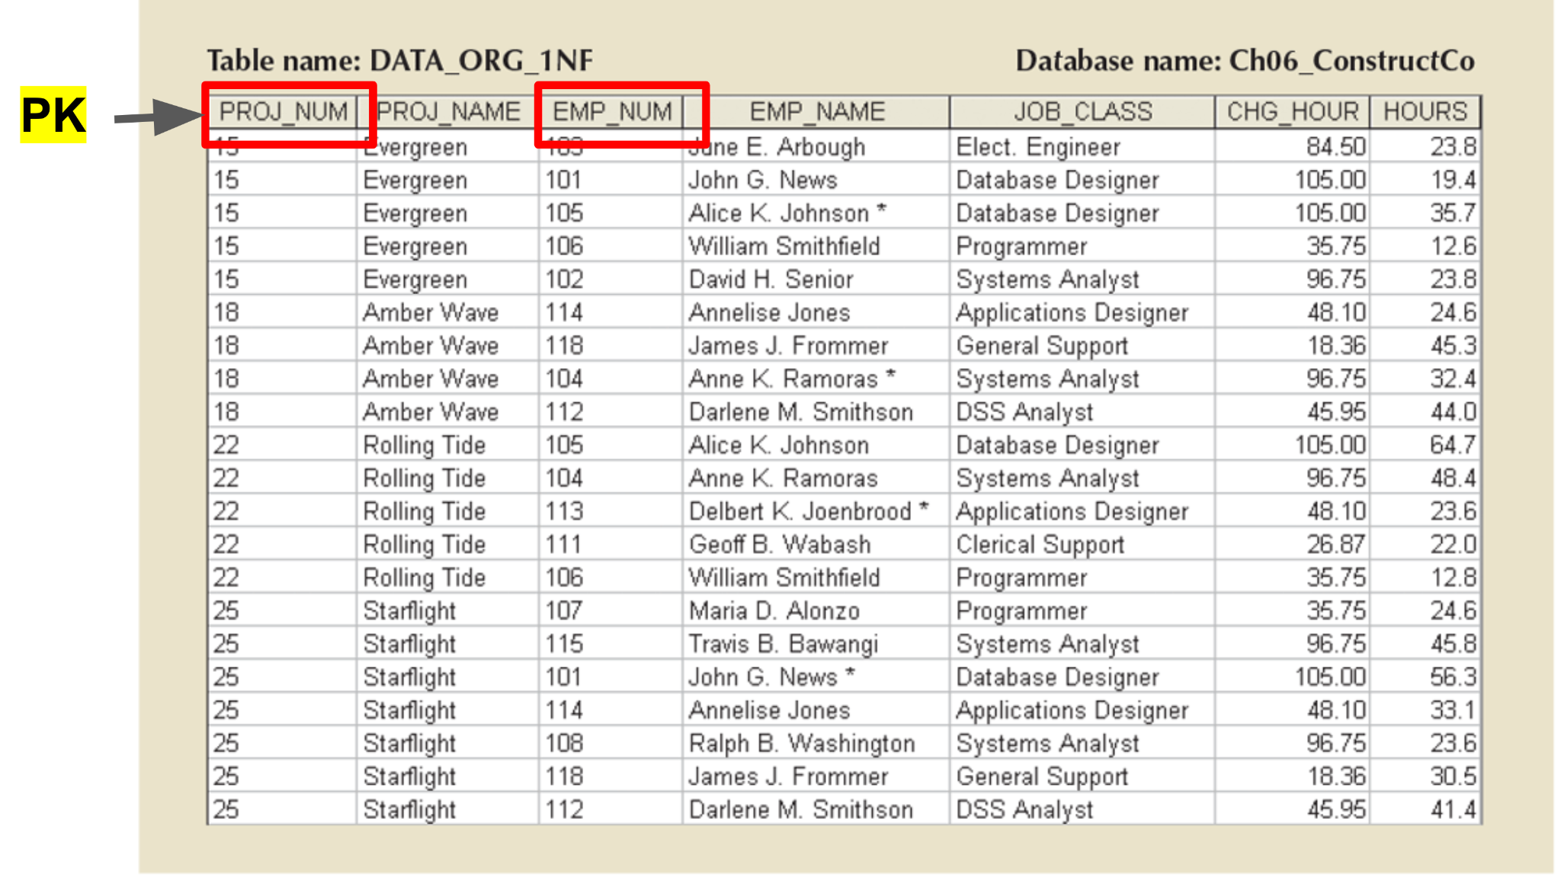
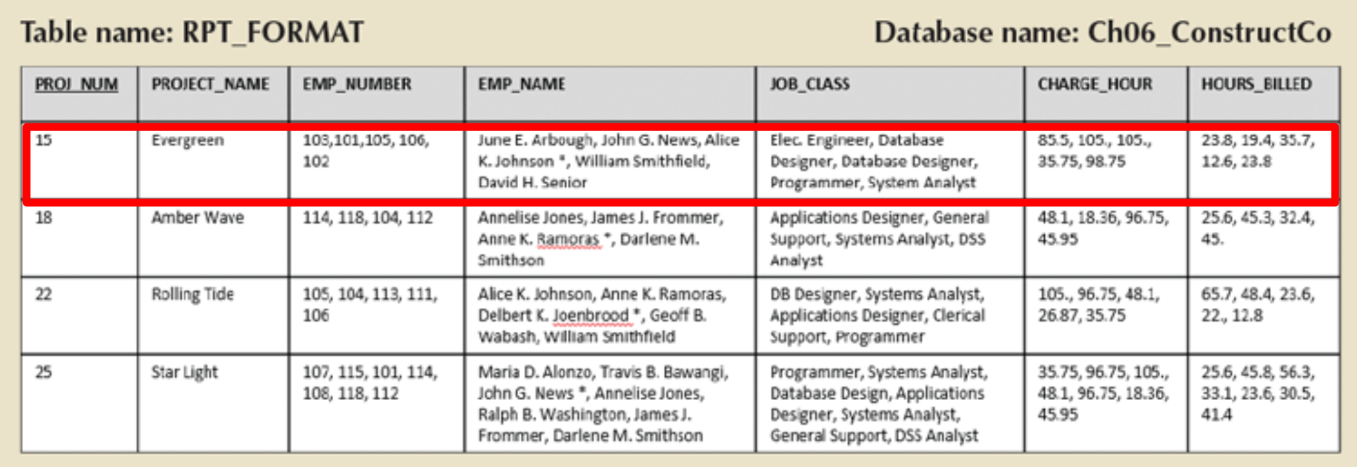
First Normal Form (1NF)
Each cell holds one value (atomic).
Rows uniquely identified.
After (removing repeating groups)
Before (with repeating groups of attributes)

Slide 17
Eliminating Repeating Groups
To normalize a table, we first put it in a proper table format so that each row and column -- each cell -- represents a single value.

Slide 18
Before: Each row represented information about a single project. Including all people working on it and the work they’ve done → So the PK was PROJ_NUM

Slide 19
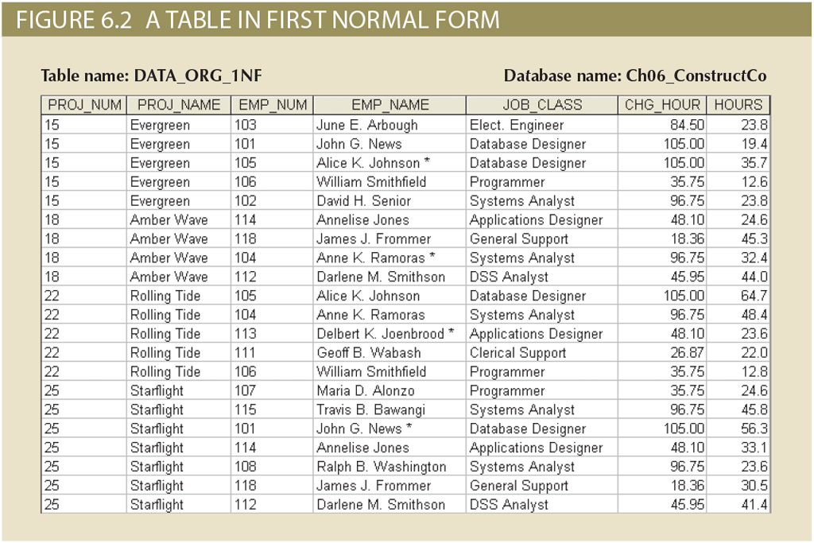
Each row represents the work of a particular employee in a specific project, so both PROJ_NUM and EMP_NUM identify the row →
PK is (PROJ_NUM + EMP_NUM)

Slide 20
The Normalization Process
Notice that so far we have:
eliminated repeating groups of attributes so that each row and column contains only one value.
identified the new Primary Key
...

Slide 21
3. Identify Functional Dependencies

Slide 22
Partial Dependency
Occurs when a non-key attribute depends only on part of a composite key (and not the whole key)
Can you detect any partial dependencies in the 1NF table we have so far?

Slide 23
Notice how PROJ_NAME depends only on PROJ_NUM.
Knowing a project’s number, we can determine the project’s name because only one name is associated with any given project number.
I.e. we do not need to know the the entire key (PROJ_NUM, EMP_NUM) to determine PROJ_NAME. Which tells us the key in this table is not a good key as it is not minimal.
PROJ_NUM→ PROJ_NAME

Slide 24
Similarly, given an employee’s number alone, we would know their name, job class and charge per hour:
EMP_NUM → (EMP_NAME, JOB_CLASS, CHG_HOUR)

Slide 25
Partial Dependency
Occurs when a non-key attribute depends only on part of a composite key (and not the whole key)
Two partial dependencies in this table:
PROJ_NUM → PROJ_NAME
EMP_NUM →
EMP_NAME, JOB_CLASS, CHG_HOUR

Slide 26
Consider anomalies that could happen if we want to:
update the JOB_CLASS → should update many entries
insert a new employee → should be associated with a project / need for a phantom entity
delete an employee → project info might get deleted!
Also nothing prevents the user from typing slightly different versions of the same data

Slide 27
A Table in 1NF (i.e. any relational table) can still be subject to data redundancies, if there are any partial dependencies.

Slide 28
Second Normal Form (2NF)
2NF = 1NF + no partial dependencies.
To remove partial dependencies, we:
Create a separate table for each partial dependency
Reassign dependent attributes
X → Y
Determinant
Dependent

Slide 29
Create New Tables
The determinants of the PDs each become the PK of a new table:
PROJECT(PROJ_NUM)
EMPLOYEE(EMP_NUM)
Also, the original table remains in the DB:
ASSIGNMENT(PROJ_NUM, EMP_NUM)
New Tables

Slide 30
2. Re-assign Dependent Attributes
PROJECT (PRJ_NUM, PROJ_NAME)
EMPLOYEE (EMP_NUM, EMP_NAME, JOB_CLASS, CHG_HOUR)
ASSIGNMENT (PROJ_NUM, EMP_NUM, ASSIGN_HOUR)
Any attribute not partially dependent remains in the original table
The dependent attributes are moved over and removed from the original table

Slide 31
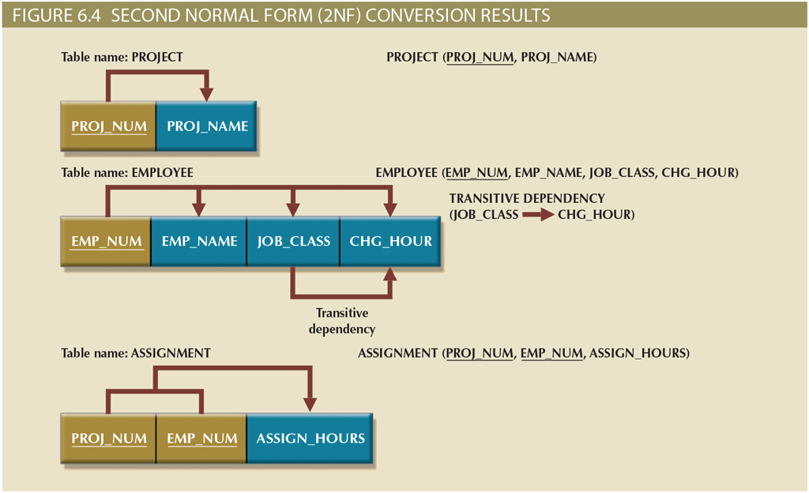

Slide 32
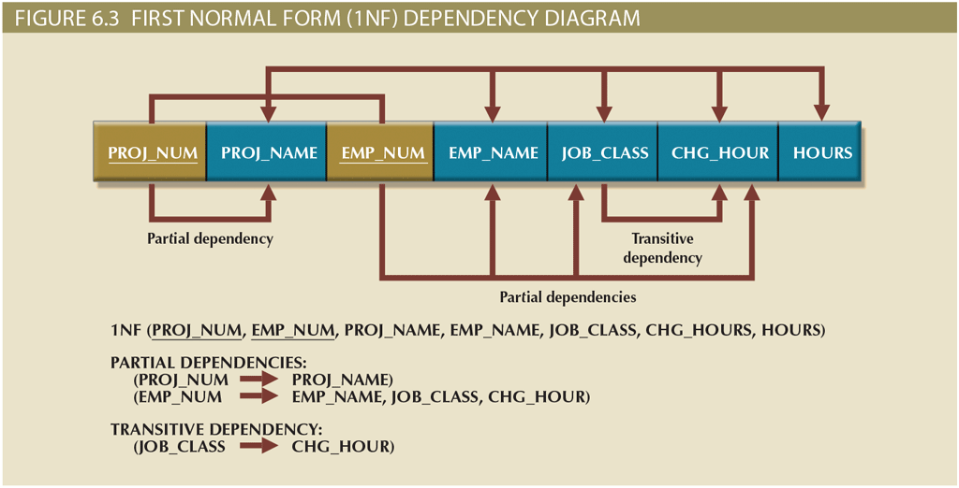

Slide 33
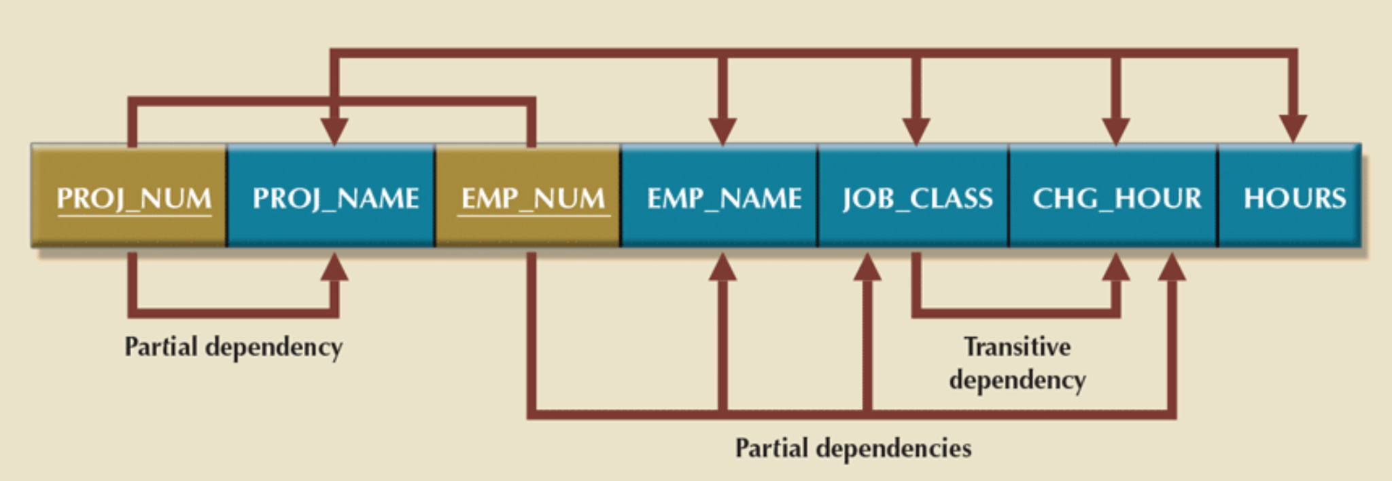
Transitive Dependency
Occurs when we have attributes in a table that only indirectly depend on the key. In fact they depend on an attribute which is not a candidate key in this table.
Example: EMP_NUM → JOB_CLASS→ CHG_HOUR

Slide 34
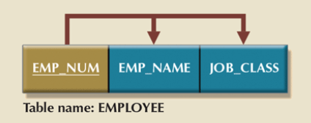
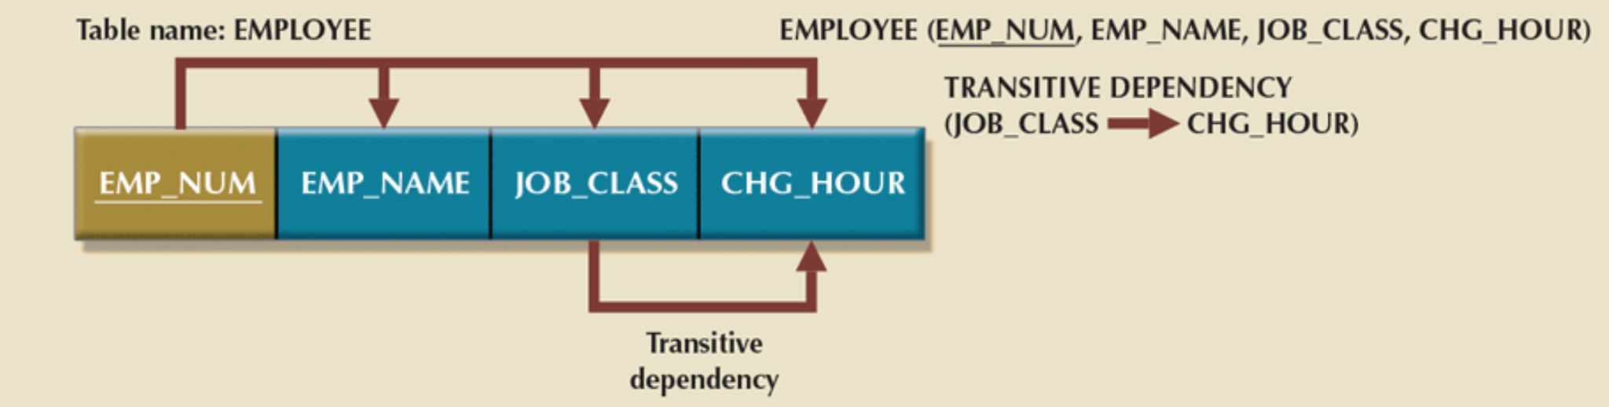
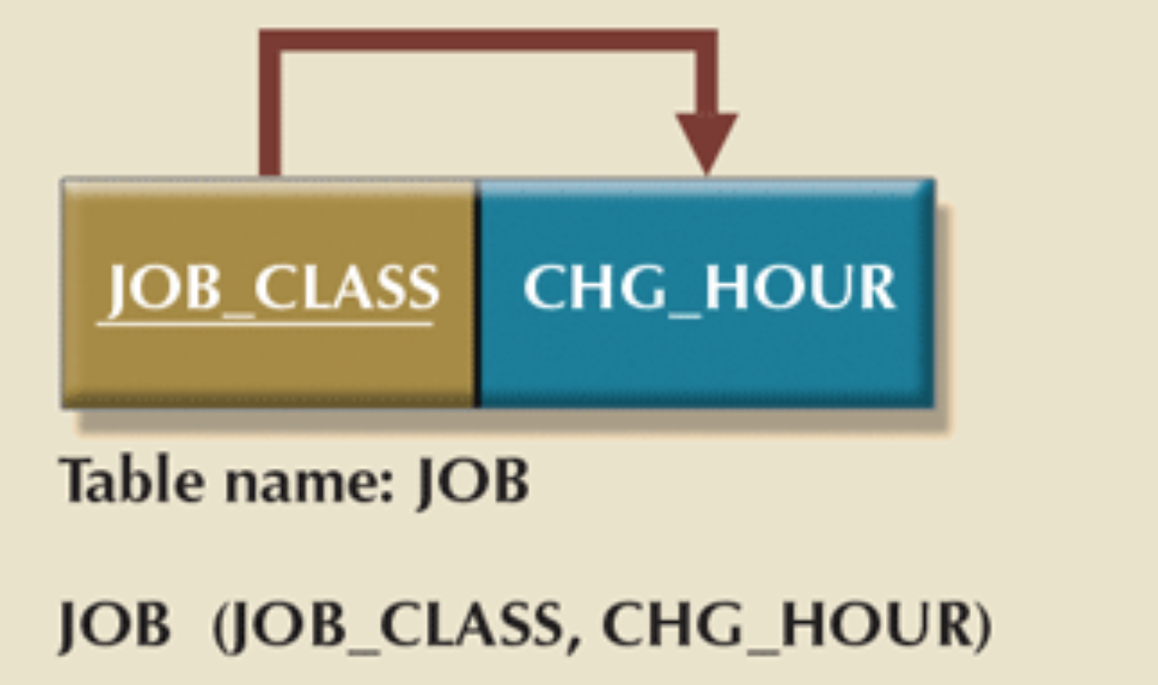
Eliminating transitive dependencies
Create a new table for each dependency.
Move the dependant attribute(s) to the new table.
Keep a copy of the determinant in the original.

Slide 35
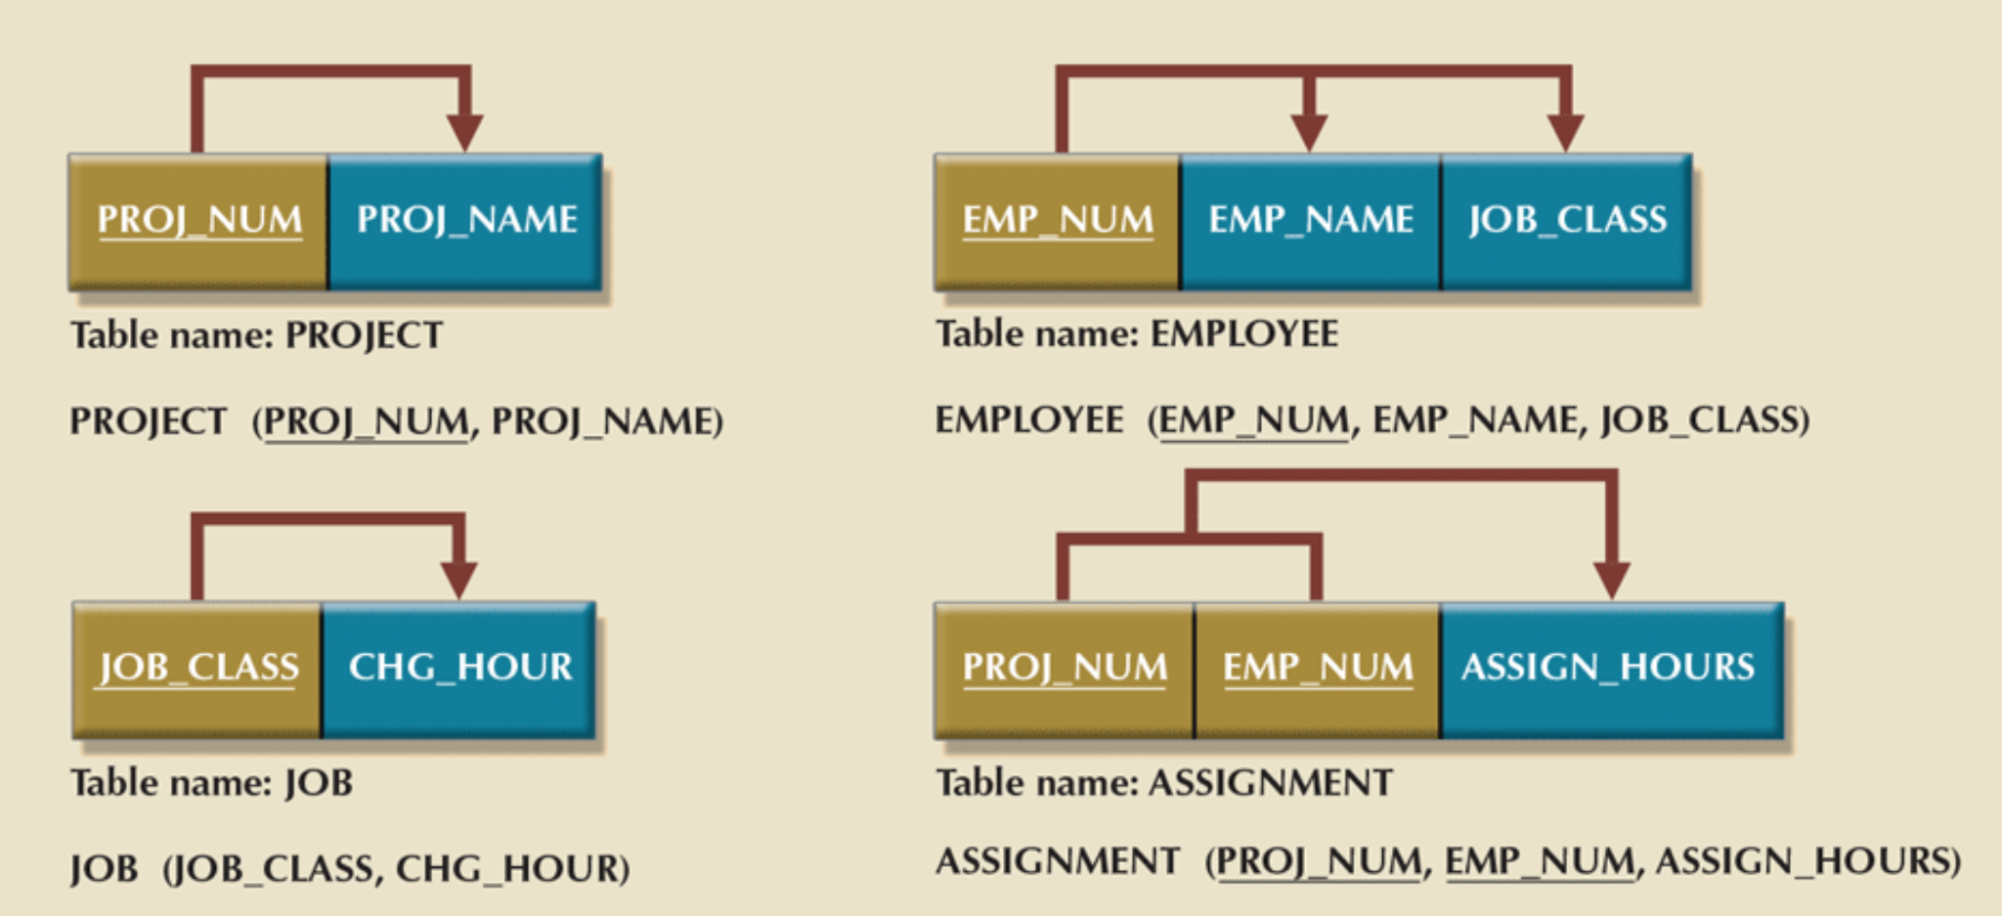
Third Normal Form (3NF)
3 NF = 2NF + no transitive dependencies:

Slide 36
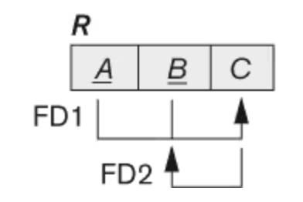
Boyce-Codd Normal Form (BCNF)
Refinement of 3NF.
Difference from 3NF: 3NF allows certain exceptions (if the dependent attribute is part of a candidate key), but BCNF removes all exceptions.
Rule: For every FD X → Y, X must be a superkey.
Practical note: In most cases, if a schema is in 3NF it is also in BCNF. The only exception is when there exists an FD X → A where X is not a superkey and A is a prime attribute. In such cases the schema is in 3NF but not BCNF.

Slide 37
Decomposition Principles
When decomposing, ensure:
Lossless-join: join of decomposed tables = original table.
Rule: shared attribute must be a key in one table.
Dependency preservation: all FDs must still hold.

Slide 38
The Normalization Process
eliminate repeating groups of attributes so that each row and column contains only one value.
identify the new Primary Key
Identify all dependencies
Eliminating partial dependencies → 2NF
Eliminating transitive dependencies → 3NF
Check BCNF
Verify lossless-joins + dependency preservation

Slide 39
Some Notes on Normalization
Two ways to apply normalization:
Examine initial ERD to see if the design can be improved by Normalization
More often, the DB designer is asked to modify existing data structures (files, spreadsheets, or existing DB structures)
Optimal implementation → requires at least 3NF
Normalization purity is often difficult to sustain in the modern database environment
Sometimes redundancy is kept intentionally:
For performance.
For reporting/analytics.
Trade-off: efficiency vs consistency.

Slide 40
Summary
FDs = discover hidden redundancy.
Normalization = remove anomalies stepwise.
1NF → atomic values.
2NF → no partial dependencies.
3NF → no transitive dependencies.
BCNF → every FD has a superkey.
Always check: lossless-join + dependency preservation.

